Slide 1
CHAPTER 2
MANAGEMENT THEORY
Essential Background for the Successful Manager

Slide 2
PROGRESSION OF MANAGEMENT PERSPECTIVES

Slide 3

Classical viewpoint: Scientific Management
Identified 17 basic motions to manipulate efficiency
Reinforced the link between physical movements in a job and workers’ efficiency.
Bettmann/Getty Images

Slide 4
Administrative Management
Weber believed bureaucracy was a rational, efficient, ideal organization based on principles of logic.
A well-defined hierarchy of authority, with no flexibility
Formal rules and procedures
Impersonality

Slide 5

The Problem WITH Classical Viewpoint: Too Mechanistic
A flaw in the classical viewpoint: viewed humans as cogs within a machine,.

Slide 6

Behavioral Viewpoint
Emphasized the importance of understanding human behavior
and
motivating employees

Slide 7
Early Behaviorism
Hugo Munsterberg said psychologists could contribute by:
Studying jobs and which people are best suited to specific jobs.
Identify psychological conditions under which employees work best.
Devise strategies to influence employees

Slide 8
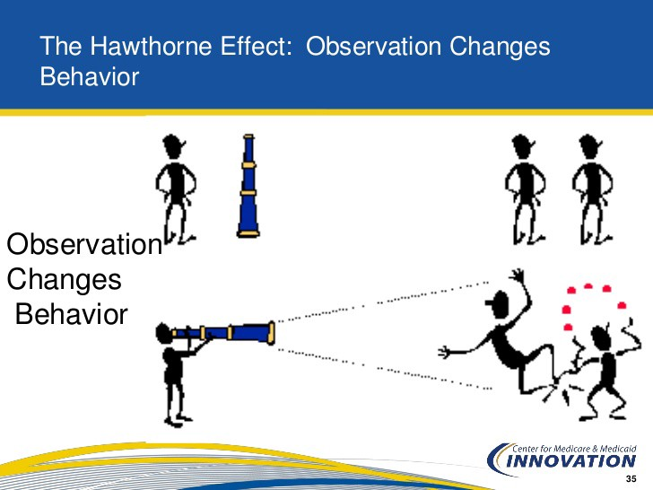
Harvard research group to conduct worker productivity studies at Western Electric’s Hawthorne (Chicago) plant in the late 1920s.
Hawthorne Effect:
Employees worked harder if:
Received added attention, or
Thought managers cared about their welfare, or
Thought supervisors paid attention to them

Slide 9

Human Relations Movement: Pioneered BY Maslow
Abraham Maslow’s Hierarchy of Needs
Maslow observed that his patients had certain innate needs that had to be satisfied before they could reach their fullest potential.

Slide 10
Human Relations Movement: Pioneered BY McGregor
Douglas McGregor came to realize that managers needed to be aware of attitudes toward employees
These attitudes could be thought of as either “X” or “Y”
Theory X: pessimistic, negative view of workers. Workers are irresponsible, lack ambition and hate work.
Theory Y: human relations outlook. Optimistic, positive view of workers as capable, having self-direction, self-control, being imaginative and creative.

Slide 11

THE BEHAVIORAL SCIENCE APPROACH: Recap
The disciplines of behavioral science include:
Psychology
Sociology
Anthropology
Economics

Slide 12
Operations Management: Being More Effective
Operations management consists of all the job functions and activities of managers.
Management meets supply chain!
Schedule and delegate work and training,
Plan production,
Design services customers want,
Locate and design company facilities, and
Choose optimal levels of product inventory.

Slide 13
The Four Parts of a System (Approach)
The four parts of a system are:
Inputs
Transformational processes
Outputs
Feedback
Systems may be open or closed.

Slide 14
Contingency Viewpoint
The beauty, and simplicity, of contingency theory lies in the proposition that there is not one best way to manage.

Slide 15
Contemporary approach: The Learning Organization - Sharing Knowledge AND Modifying Behavior
Keep on learning.
Individuals who embrace learning make the organization smarter.
Challenge for managers is to establish a culture of shared knowledge.
Three parts of a learning organization:
Creating and acquiring knowledge
Transferring knowledge
Modifying behavior

Slide 16
High-Performance Work Practices
HPWP argues: the job of management is to create human resource practices for employee development and well-being.
High-performance work practices include:
Ability-enhancing practices (I can do my job)
Motivation-enhancing practices (I want to do my job)
Opportunity-enhancing practices (I want to stay at this company)

Slide 17

Shared Value AND Sustainable Development: Going beyond Profits
- Look beyond short-term profits
- Focus on meeting needs of the present without compromising the ability of the future

